Slide 1
Approximate Nearest Neighbor Search in Information Retrieval
Guilherme Klein Gomes
Machine Learning Engineer at ADP Brazil Labs
guiligomes@gmail.com
linkedin.com/in/guilherme-klein-gomes-3218b7127/
https://github.com/GuiliGomes

Slide 2
Motivation - Roll by Adp

Slide 3



Roll by ADP
https://www.rollbyadp.com/
Complete mobile HCM solution based on Virtual Chat Assistant:
Recruiting
Hiring
Payroll
Taxes Filling
Time

Slide 4


Roll by ADP - NLP
NLP Tasks:
Named Entity Recognition (NER) for persons, companies, amounts, dates, job positions, documents, etc.
Part Of Speech (POS) tagging for sentence pre-processing.
Spell Checking.
Intent Classification.
Question Answering with Information Retrieval on multiple knowledge bases.

Slide 5
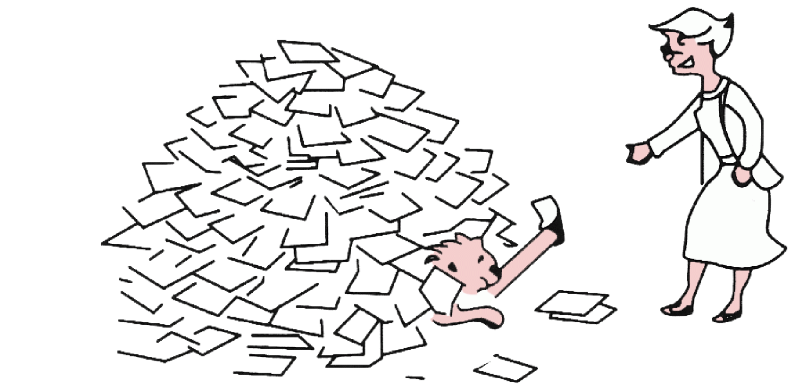
Information Retrieval
Examples:
Web Search Engine
Email Search
Blog Search
Recommender Systems
Apple’s Mac OS X Spotlight
Enterprise, institutional, and domain-specific search
Question Answering
Information Retrieval (IR) is finding material (usually documents) of an unstructured nature (usually text) that satisfies an information need from within large collections (usually stored on computers)*

Slide 6
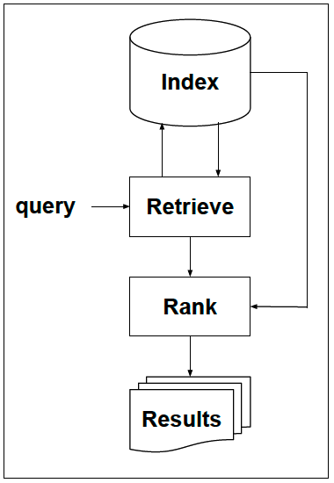
Information Retrieval
The "Retrieve - Then - Rank" Paradigm

Slide 7
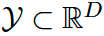
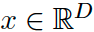
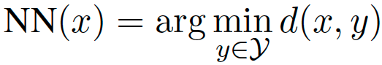
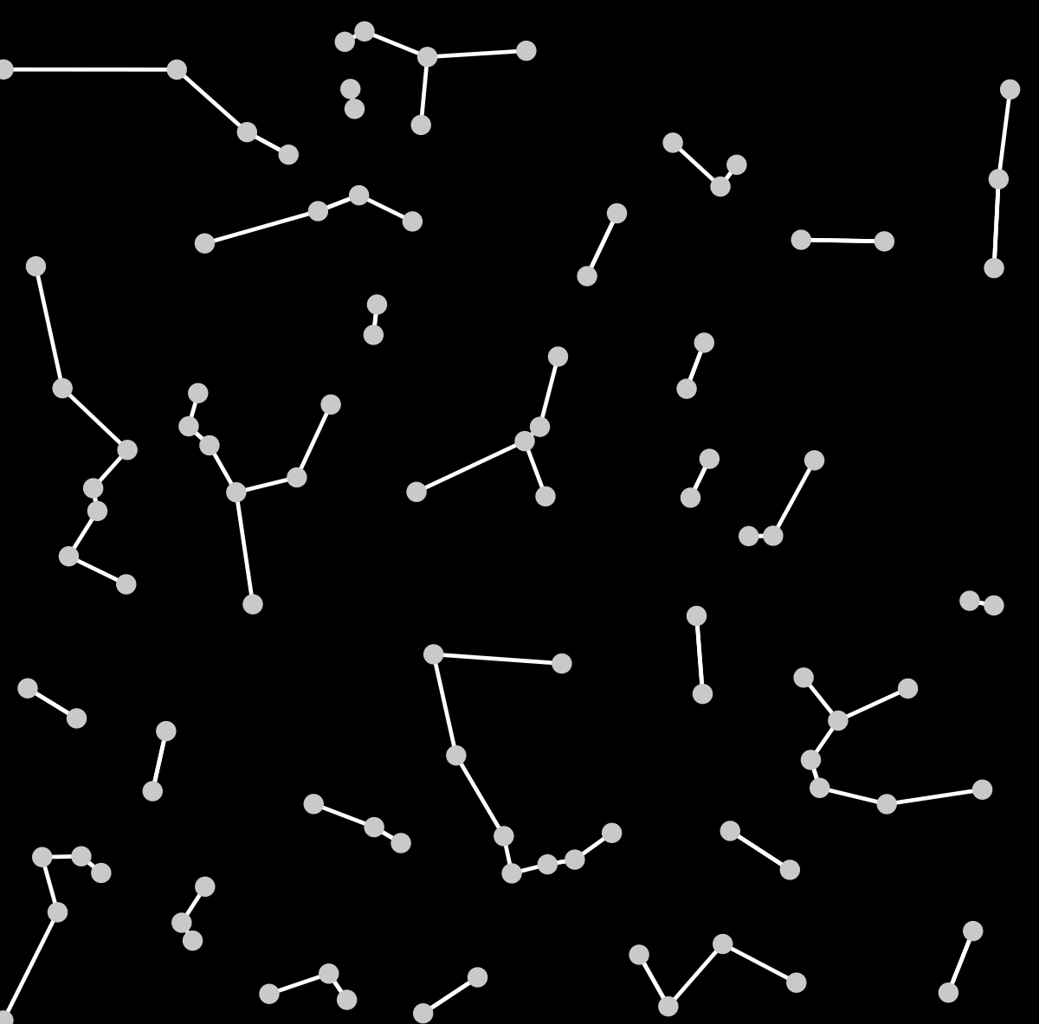
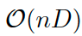
NNS - Nearest Neighbor Search
The problem of finding the element NN(x), in a finite set f of of n vectors, minimizing the distance to the query vector :
Exact Nearest Neighbor Search (NNS) is an exhaustive search:
Most modern applications have massive data with high dimensionality. For those cases NNS becomes impractical and Approximate Nearest Neighbor Search (ANNS or ANN) takes its place.
With the advances of Representation Learning and the production of dense vectors with semantically-rich document representations, ANN gained more relevance in high scale similarity search applications.

Slide 8
NNS - Nearest Neighbor Search

Slide 9
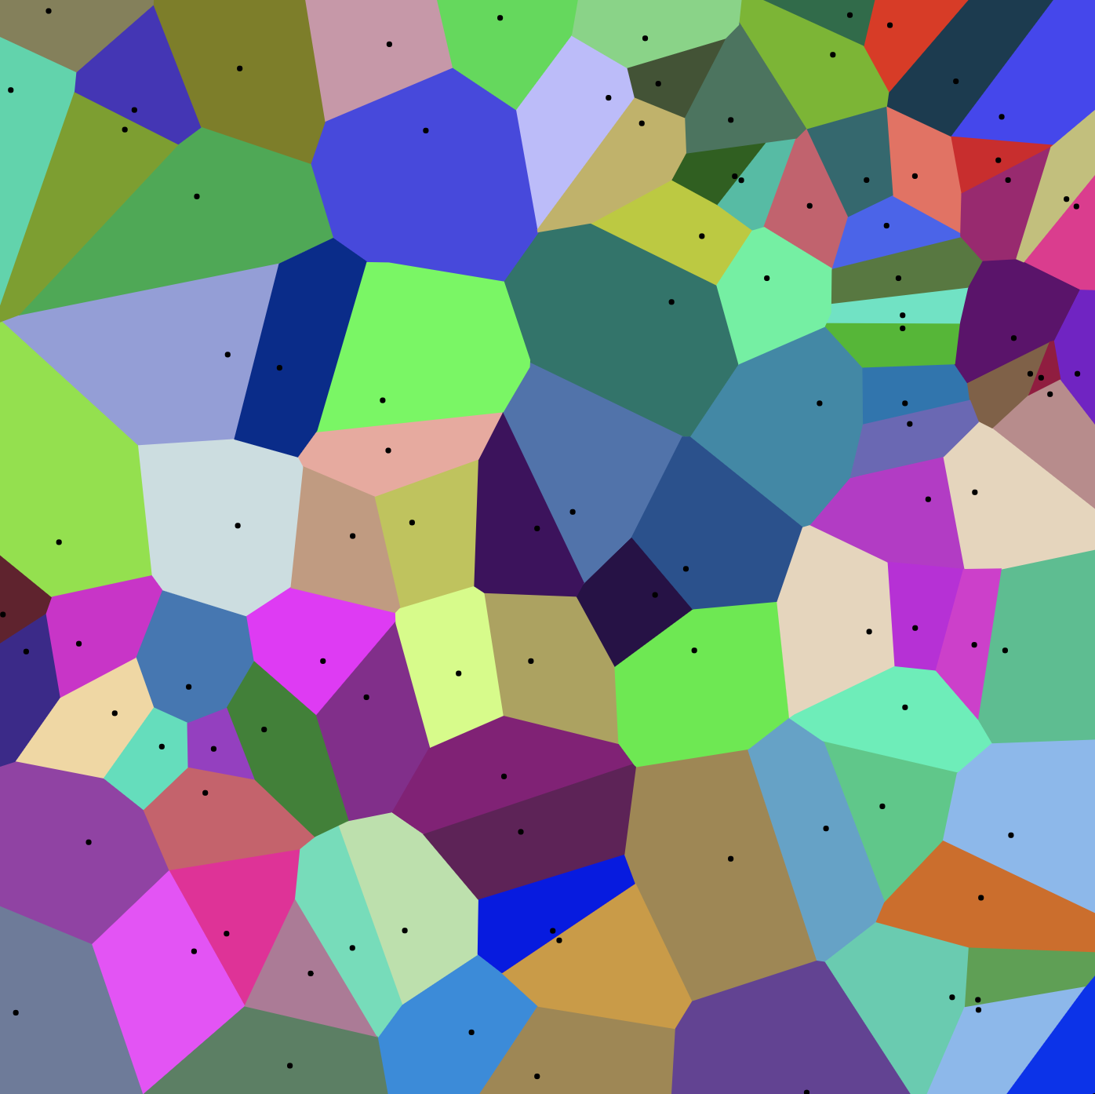
Voronoi Diagram
"A partition of a plane into regions close to each of a given set of objects (called seeds, sites, or generators). For each seed there is a corresponding region, called a Voronoi cell, consisting of all points of the plane closer to that seed than to any other."

Slide 10
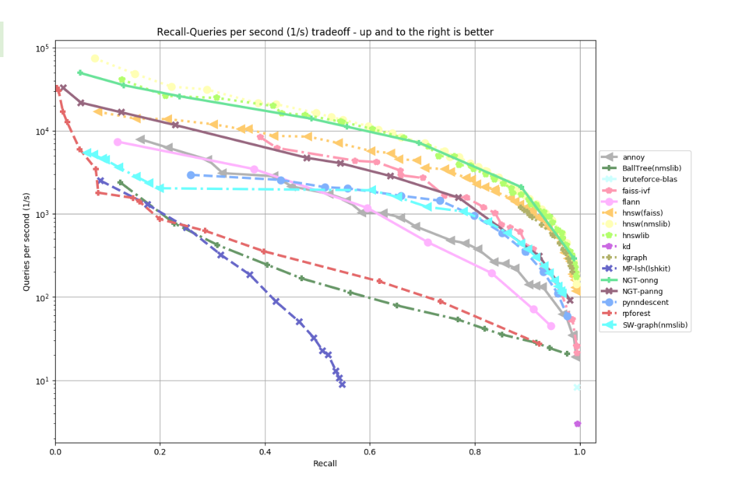
ANN Algorithms
ANN Paradigms:
Local Sensitive Hashing (LSH)
Trees
Product Quantization
Proximity Graphs

Slide 11
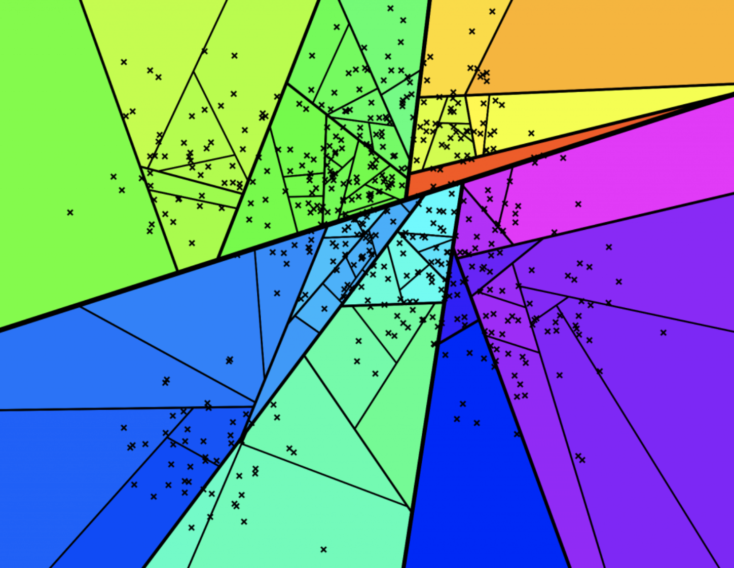
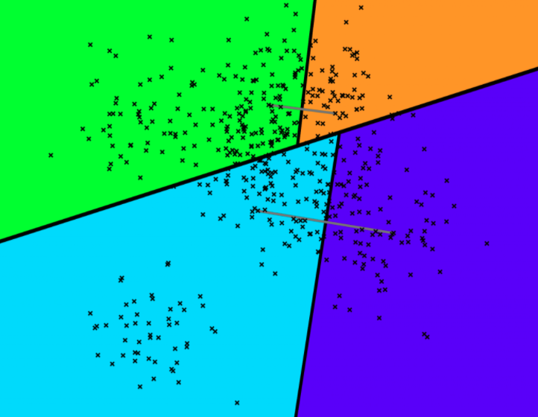
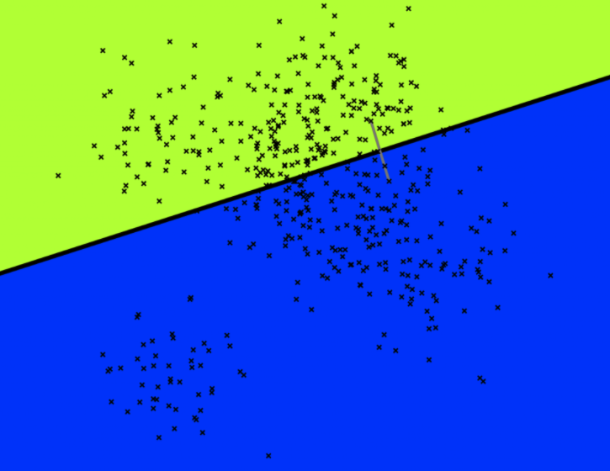
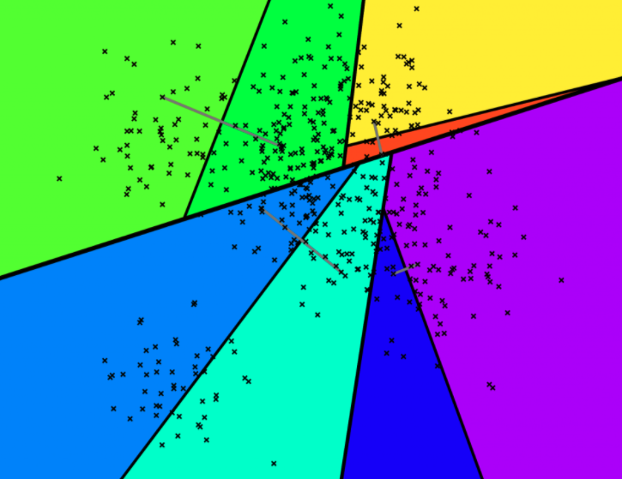
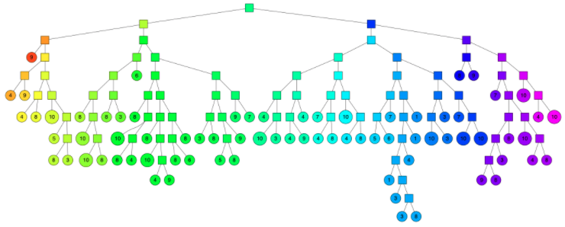
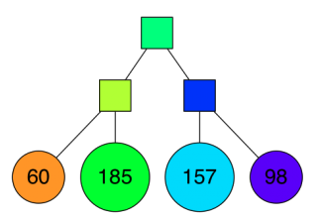
ANNOY - Index
Constructs forests (collections of trees) as index data structure by splitting the dataset.
Most prominent solution is ANNOY, from Spotify:
"Approximate Nearest Neighbor Oh Yeah"
Search complexity is logarithmic

Slide 12
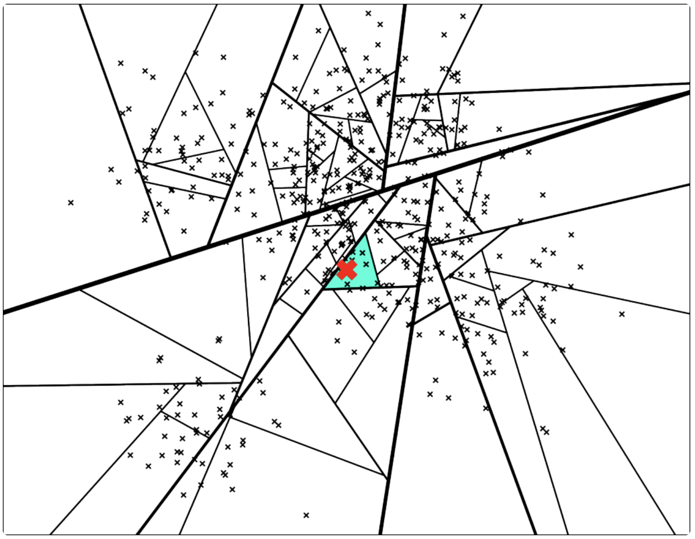
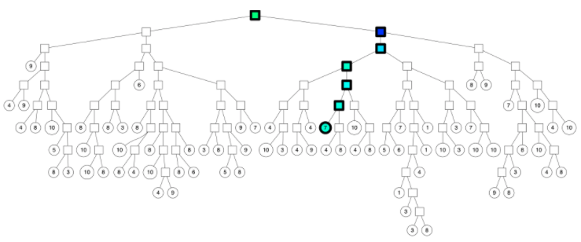
ANNOY - Search
Traverses the binary tree from the root:
Two issues:
The max number of nearest neighbors is limited by the number of each node (polygon).
Some of the nearest neighbors are outside the polygon.

Slide 13
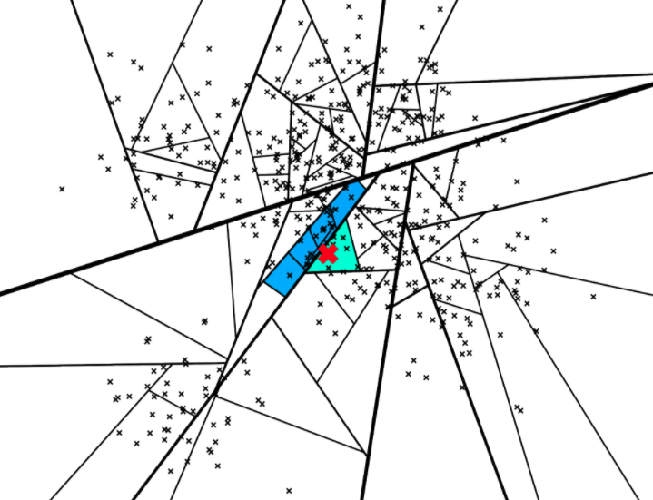
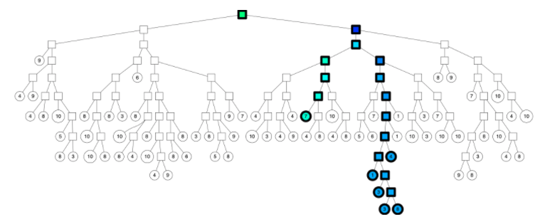
ANNOY - Search Tricks
Explore part of wrong paths:

Slide 14
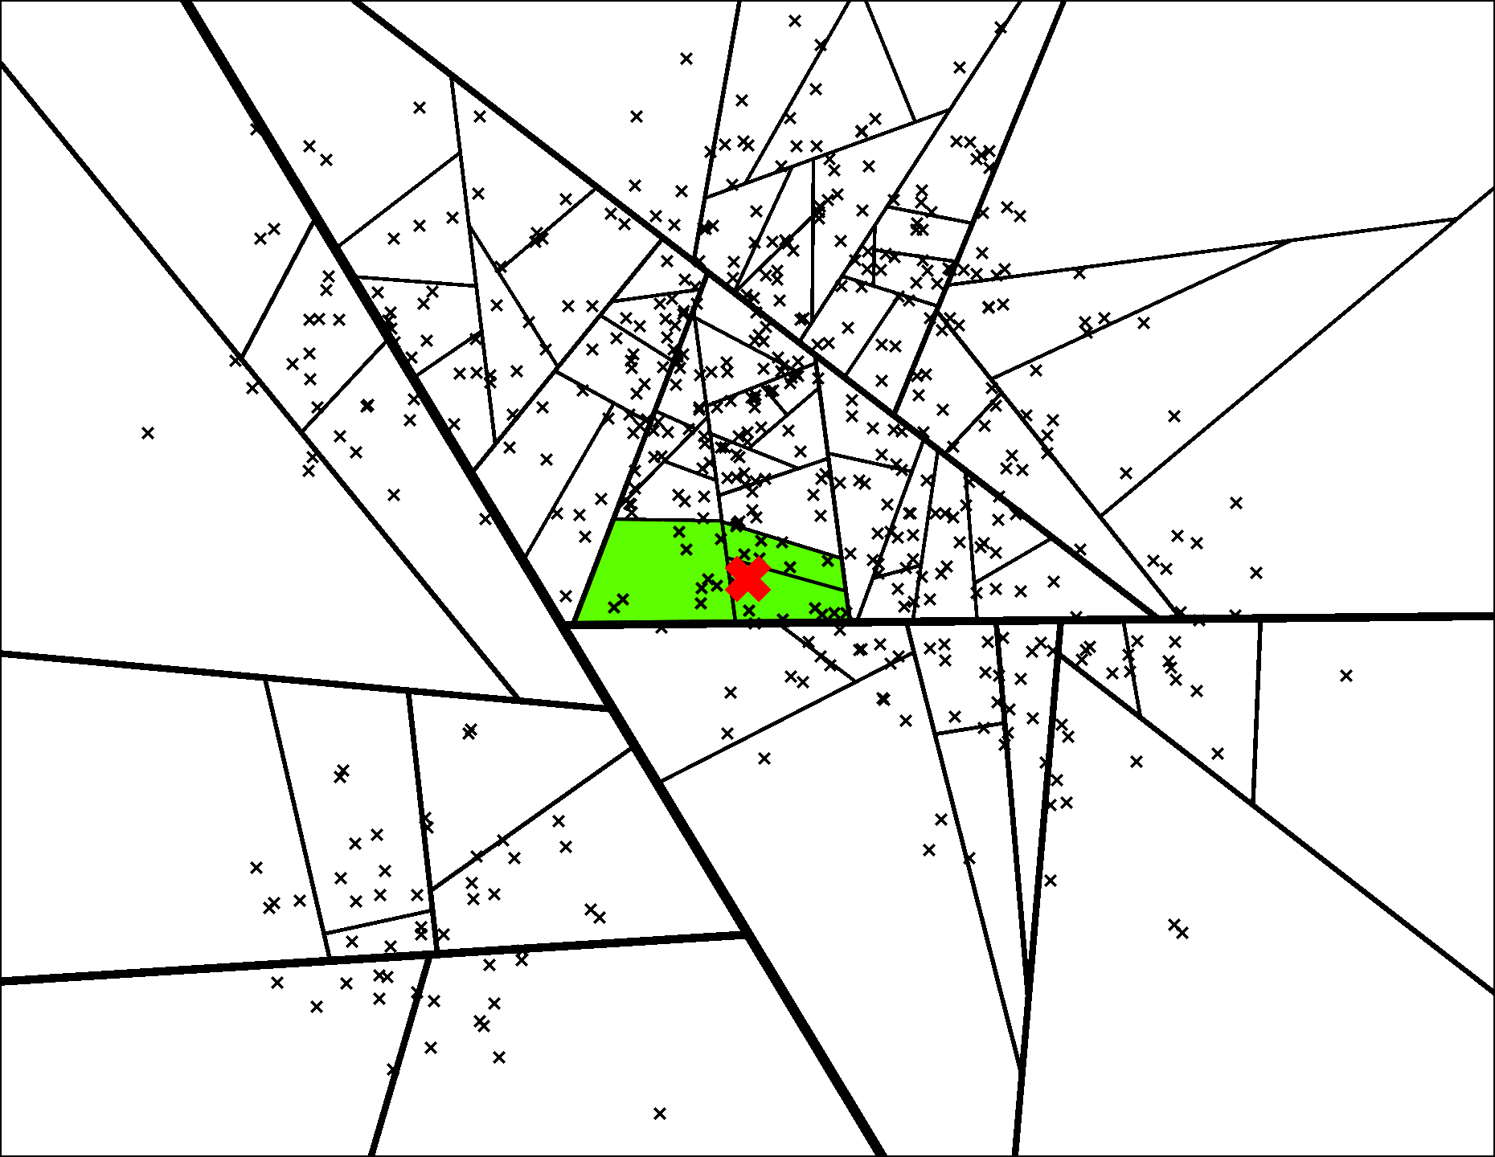
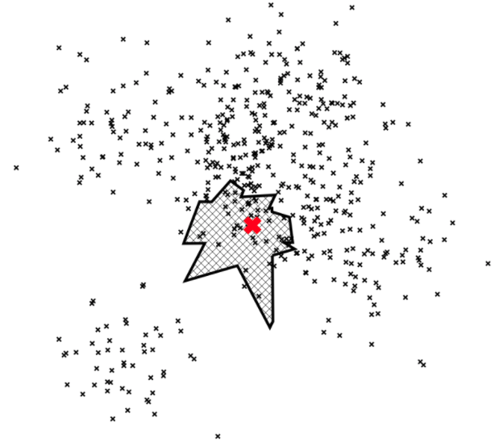
ANNOY - Search Tricks
Forest of Trees:

Slide 15
ANNOY - Summary
Pros:
Small memory usage.
Memory sharing between processes.
Fast index loading.
Build index on disk to enable indexing big datasets that won't fit into memory.
Cons:
The exact nearest neighbor might be across the boundary to one of the neighboring cells.
No support for GPU processing.
Can't query or incrementally add new points to it.

Slide 16
PQ - Product Quantization ANN

Slide 17
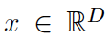
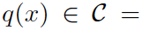
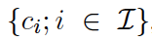
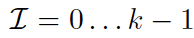
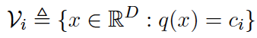
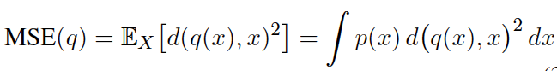
PQ - Vector Quantization
"A destructive process with the purpose to reduce the cardinality of the representation space, in particular when the input data is real-valued"
Quantizer:
Function q mapping a D-dimensional vector to a vector , with .
The reproduction values ci are called the centroids, and they form the set C called codebook of size k. The set Vi of vectors mapped to a given index centroid is referred as Voronoi Cell:
(1)
The quality of a quantizer is usually measured by the mean squared error between the input vector x and its reproductible value q(x):
(2)
Sources:
H. Jegou, M. Douze, and C. Schmid, "Product quantization for nearest neighbor search," Pattern Analysis and Machine Intelli-gence, IEEE Transactions on, vol. 33, no. 1, pp. 117-128, 2011.

Slide 18
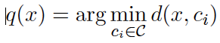
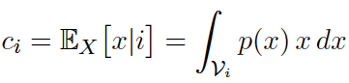
PQ - Vector Quantization
In order for the quantizer to be optimal, it has to satisfy two properties known as the Lloyd Optimality Conditions:
1. A vector x must be quantized to its nearest codebook centroid, in terms of the Euclidean distance:
(3)
2. The reconstruction value ci must be the expectation of the vectors lying in the Voronoi Cell:
(4)
Let's consider a 128-dimensional vector: A 64-bit quantizer (just "half-bit" per dimension) will have k = 2^26 centroids Curse of Dimensionality!!!
Sources:
H. Jegou, M. Douze, and C. Schmid, "Product quantization for nearest neighbor search," Pattern Analysis and Machine Intelli-gence, IEEE Transactions on, vol. 33, no. 1, pp. 117-128, 2011.

Slide 19
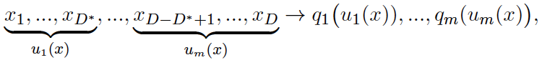
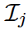
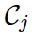
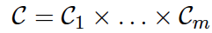
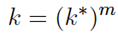
PQ - Product Quantizers
The input vector x is split into m distinct subvectors uj , 1 ⩽ j ⩽ m of dimension D* = D/m, where D is a multiple of m.
The subvectors are quantized separately using m distinct quantizers. The original vector x is mapped as
(5)
… where qj is a low-complexity quantizer associated with the jth subvector, having its associated index set and codebook with the corresponding reproduction values cij.
The codebook is therefore defined by the cartesian product and a centroid is given by the concatenation of the centroids of the m subquantizers. The total number of centroids is given by:
Sources:
H. Jegou, M. Douze, and C. Schmid, "Product quantization for nearest neighbor search," Pattern Analysis and Machine Intelli-gence, IEEE Transactions on, vol. 33, no. 1, pp. 117-128, 2011.

Slide 20
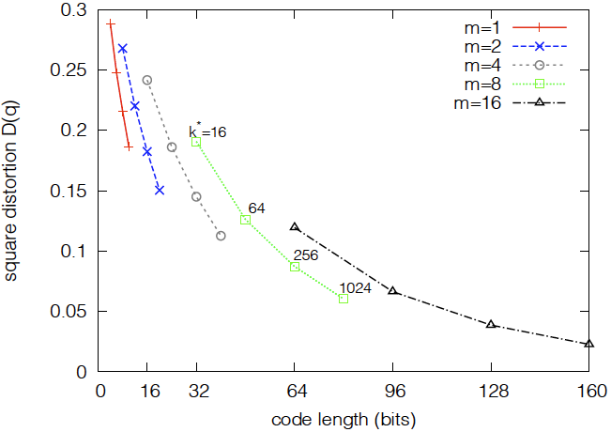
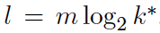
PQ - Product Quantizers
Influence of k and m parameters
Code Length l represents the total resolution (in bits) of all the subquantizers:
(6)
… being k* a power of two.
For a fixed number of bits, it is better smaller number of subquatizers with many centroids than having bigger number of subquantizers with a few bits.
Sources:
H. Jegou, M. Douze, and C. Schmid, "Product quantization for nearest neighbor search," Pattern Analysis and Machine Intelli-gence, IEEE Transactions on, vol. 33, no. 1, pp. 117-128, 2011.

Slide 21
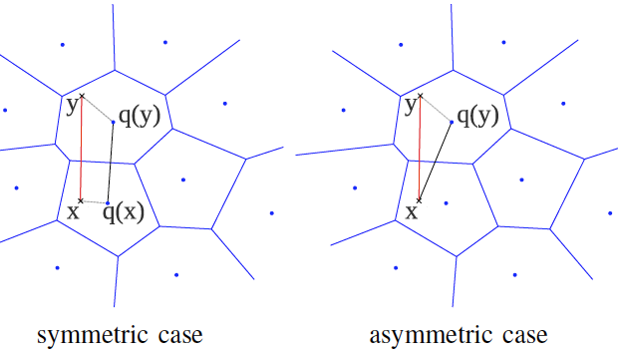
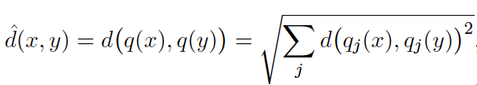
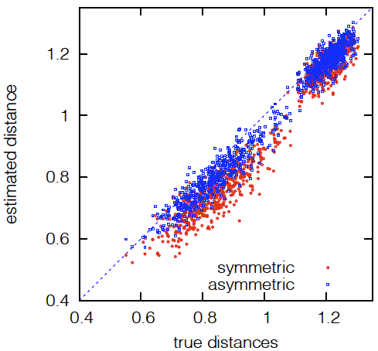
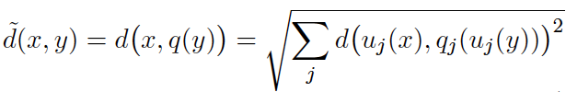
PQ - Searching with Quantization
NNS is based on distances between a query vector and the database vectors. For PQ the distances can be computed based on the representation values (centroids). [13] proposes two methods:
Symmetric Distance Computation (SDC): Both x and y are represented by their centroids. The distance d(x,y) is approximated by (pre-computed) the distance d(q(x),q(y)):
(2)
Asymmetric Distance Computation (ADC): The database vector y is represented by q(y) but the query x is not encoded. The distance d(x,y) is approximated by (pre-computed) the distance d(x,q(y)) computed by the decomposition:
Sources:
H. Jegou, M. Douze, and C. Schmid, "Product quantization for nearest neighbor search," Pattern Analysis and Machine Intelli-gence, IEEE Transactions on, vol. 33, no. 1, pp. 117-128, 2011.

Slide 22
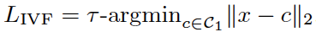
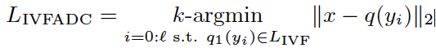
PQ - Non-Exhaustive Search
Given a collection of objects and being q(yi) the quantized value of the ith object in the collection, the asymmetric distance computation is given by:
(7)
Product quantizers makes search faster and reduces memory usage, but the search is still exhaustive since all elements on the collection need to be evaluated. To avoid exhaustive search, Inverted File Index is used:
(8)
… where i is the multi-probe parameter to pre-select centroids. The quantizer operates a nearest-neighbor search with exact distances, in the set of reproduction values. Then, the IVFADC [13] search computes ADC only in Vi:
(9)
Sources:
H. Jegou, M. Douze, and C. Schmid, "Product quantization for nearest neighbor search," Pattern Analysis and Machine Intelli-gence, IEEE Transactions on, vol. 33, no. 1, pp. 117-128, 2011.
J. Johnson, M. Douze and H. Jegou, "Billion-scale similarity search with GPUs", IEEE Transactions on Big Data ( Volume: 7, Issue: 3, July 1 2021)

Slide 23
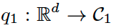
PQ - Non-Exhaustive Search
Given a collection of objects and being q(yi) the quantized value of the ith object in the collection, the Asymmetric Distance Computation (ADC) is given by:
(7)
Product quantizers makes search faster and reduces memory usage, but the search is still exhaustive since all elements on the collection need to be evaluated.
To avoid exhaustive search an Inverted File Index (IVF) is used to pre-select a subset of elements for which distance is computed. A coarse quantizer q1 encodes the elements into a set C1 representation values (centroids):
… and the elements are mapped to the corresponding Voronoi cells.
Sources:
H. Jegou, M. Douze, and C. Schmid, "Product quantization for nearest neighbor search," Pattern Analysis and Machine Intelli-gence, IEEE Transactions on, vol. 33, no. 1, pp. 117-128, 2011.
J. Johnson, M. Douze and H. Jegou, "Billion-scale similarity search with GPUs", IEEE Transactions on Big Data ( Volume: 7, Issue: 3, July 1 2021)

Slide 24
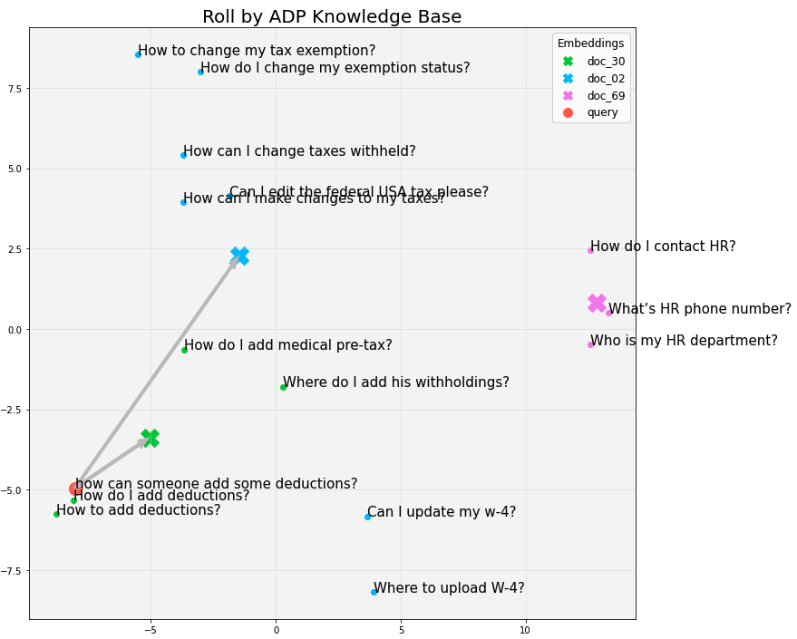
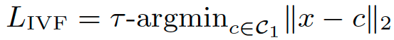
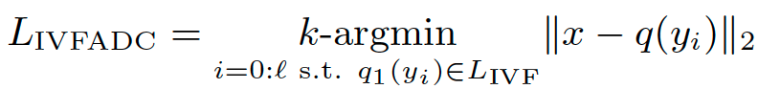
IVF - The Inverted Index File
K-means coarse quantizer q1 partitions the dataset and, at search time, only the closest partitions (Voronoi cells) are probed:
(8)
… where i is the multi-probe parameter to pre-select centroids. The quantizer operates a nearest-neighbor search with exact distances, in the set of reproduction values. Then, the IVFADC [13] search computes ADC only in Vi:
(9)
Sources:
J. Johnson, M. Douze and H. Jegou, "Billion-scale similarity search with GPUs", IEEE Transactions on Big Data (Volume: 7, Issue: 3, July 1 2021)

Slide 25
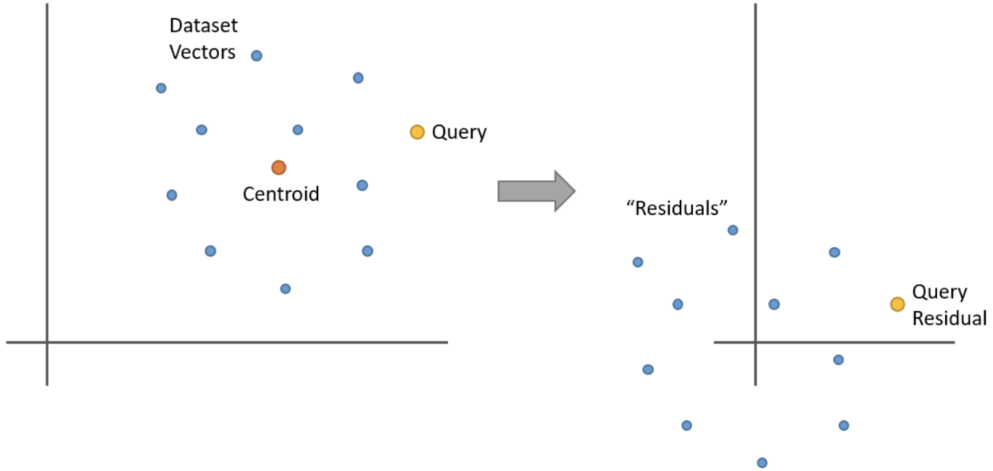
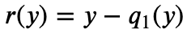
PQ - Encoding Residuals
IVFADC uses improved object descriptions q(y) by applying two levels of quantization. A coarse quantizer q1 and a fine quantizer q2 approximate the vector y as:
(10)
In order to take account the information from q1, i.e, the centroid associated with y, the fine quantizer q2 encodes the residual vector r(y) as:
(11)
The residual vector r(y) corresponds to the
offset in the Voronoi cell and has smaller energy
compared to the original vector.
Sources:
H. Jegou, M. Douze, and C. Schmid, "Product quantization for nearest neighbor search," Pattern Analysis and Machine Intelli-gence, IEEE Transactions on, vol. 33, no. 1, pp. 117-128, 2011.
J. Johnson, M. Douze and H. Jegou, "Billion-scale similarity search with GPUs", IEEE Transactions on Big Data ( Volume: 7, Issue: 3, July 1 2021)
McCormick, Chris, "Product Quantizers for k-NN Tutorial, 2017", https://mccormickml.com/2017/10/22/product-quantizer-tutorial-part-2/

Slide 26
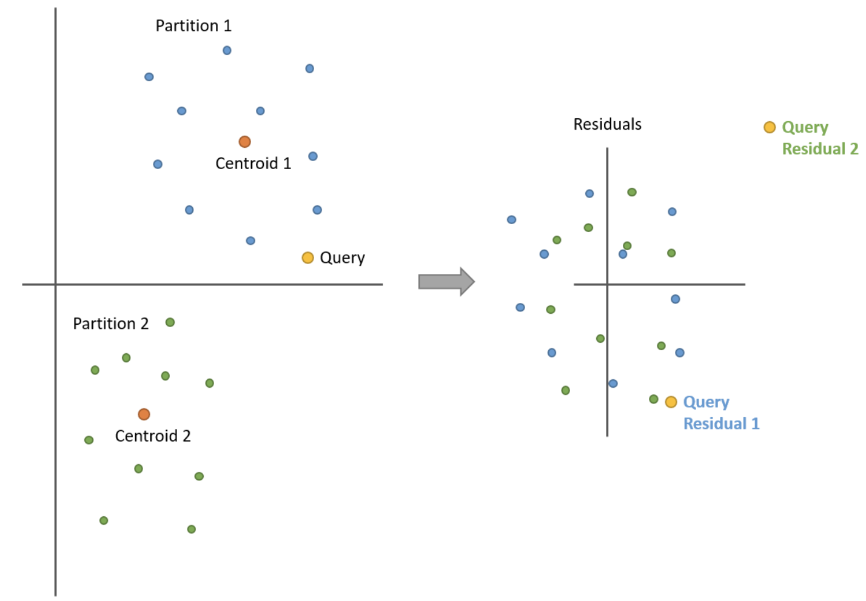
PQ - Encoding Residuals
Sources:
McCormick, Chris, "Product Quantizers for k-NN Tutorial, 2017", https://mccormickml.com/2017/10/22/product-quantizer-tutorial-part-2/

Slide 27
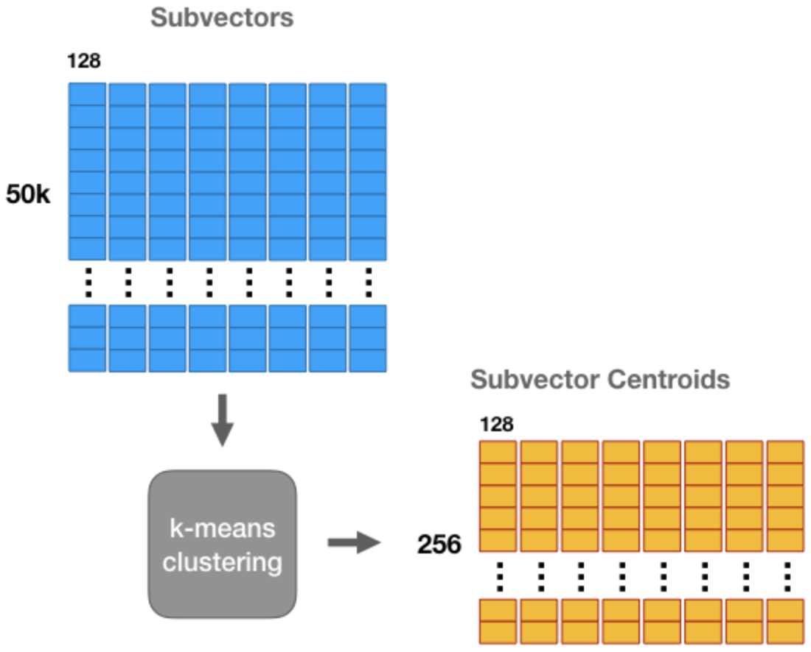


PQ - Facebook FAISS
Powerful GPU-accelerated library for billion-scale similarity search
50K Embeddings of 1024 32-bit floating points.
8 quantizers producing codebooks (b = 8).
256^8 unique values 1,84E19
Sources:
H. Jegou, M. Douze, and C. Schmid, "Product quantization for nearest neighbor search," Pattern Analysis and Machine Intelli-gence, IEEE Transactions on, vol. 33, no. 1, pp. 117-128, 2011.
J. Johnson, M. Douze and H. Jegou, "Billion-scale similarity search with GPUs", IEEE Transactions on Big Data ( Volume: 7, Issue: 3, July 1 2021)

Slide 28
PQ - Summary
Pros:
Efficient vector compression ratio.
Accuracy approximation of Euclidean distance.
Non-exhaustive search with centroid-based IVF approach, which implicitly partitions the space with a Voronoi diagram.
High level of parallelization (GPU).
Billion-scale capacity with logarithmic scaling.
Cons:
The exact nearest neighbor might be across the boundary to one of the neighboring cells.
Can't incrementally add points to the index.

Slide 29
Proximity Graphs ANN

Slide 30

Delaunay Graph or Delaunay Triangulation (DT)
"A triangulation for given set P of discrete points in a general position is a triangulation DT(P) such that no point in P is inside the circumcircle of any triangle in DT(P)"
By Gjacquenot - Own work, File:Delaunay circumcircles.png (Nü es), CC BY-SA 3.0, https://commons.wikimedia.org/w/index.php?curid=30370476

Slide 31
Delaunay Graph or Delaunay Triangulation (DT)
"A triangulation for given set P of discrete points in a general position is a triangulation DT(P) such that no point in P is inside the circumcircle of any triangle in DT(P)"
By Gjacquenot - Own work, File:Delaunay circumcircles.png (Nü es), CC BY-SA 3.0, https://commons.wikimedia.org/w/index.php?curid=30370476

Slide 32

Delaunay Graph or Delaunay Triangulation (DT)
"A triangulation for given set P of discrete points in a general position is a triangulation DT(P) such that no point in P is inside the circumcircle of any triangle in DT(P)"
The closest neighbor b to any point p is on an edge bp in the Delaunay triangulation since the nearest neighbor graph is a subgraph of the Delaunay triangulation
In the plane, the Delaunay triangulation maximizes the minimum angle
Sources:
Delaunay triangulation - https://en.wikipedia.org/wiki/Delaunay_triangulation
By Gjacquenot - Own work, File:Delaunay circumcircles.png (Nü es), CC BY-SA 3.0, https://commons.wikimedia.org/w/index.php?curid=30370476
By Gustavo - Own work, CC BY-SA 3.0, https://commons.wikimedia.org/w/index.php?curid=31819292

Slide 33


Delaunay Graph or Delaunay Triangulation (DT)
"The Delaunay triangulation of a discrete point set P in general position corresponds to the dual graph of the Voronoi diagram for P"
Source:
Delaunay_circumcircles_centers.png: Nü esderivative work: Matthias Kopsch - This file was derived from: Delaunay circumcircles centers.png:, CC BY-SA 3.0, https://commons.wikimedia.org/w/index.php?curid=18929097

Slide 34


The Small World Phenomenon
Milgram's Letter Experiment
"Six Degrees of Separation"
Stanley Milgram
Sources:
By Harvard Department of Psychology - Original publication: Harvard Faculty RegistryImmediate source: https://psychology.fas.harvard.edu/people/stanley-milgram, Fair use, https://en.wikipedia.org/w/index.php?curid=60080360
By Ageev Andrew - Own Work based on Image:Map of USA showing state names.png, CC BY-SA 3.0, https://commons.wikimedia.org/w/index.php?curid=22945395

Slide 35


The Small World Phenomenon
The Watts-Strogatz Model
Small
World
Graphs

Slide 36
The Small World Phenomenon
Jon Kleinberg:
"Why should arbitrary pairs of strangers be able to find short chains of acquaintances that link them together?"
Main Insights:
The concept of Transmission Rate. Minimizing the transmission rate of a network is not necessarily the same as minimizing its diameter.
In addition to having short paths, a network should contain latent structural cues that can be used to guide a message towards a target.
The dependence of long-range connections on the geometry of the lattice is providing precisely such implicit information.

Slide 37
NSW - Navigable Small World

Slide 38
NSW - Navigable Small World
Construction of a NSW topology graph G(V,E)
Searching for the closest element of a query q takes a form searching a vertex in G
Addition and search operations only use local information
Decentralized similarity search oriented storage systems
Multiple local greedy searches (no need for full Delaunay graph)
The navigation property makes the greedy searches to scale logarithmically
Ability to adjust search accuracy without graph structure modification
Applicable to data from general metric spaces

Slide 39

NSW - Core Idea
Construction of a NSW topology graph G(V,E)
Each object is mapped to a single and unique vertex
Edges are determined by the construction algorithm
Short-range links approximating Delaunay graph
Long-range links (red) for logarithmic scaling
Multi greedy searches traverse the graph finding local minimums

Slide 40
NSW - Search Algorithm
The algorithm keeps exploring the neighborhood of the closest elements in a greedy manner as long as it can improve the known k closest elements on each step.
If the graph of the network has the small-world property, then it is possible to choose a random vertex without any metric calculations in a number of steps proportional to the logarithm of the dataset size.
k-NNSearch(object: q, integer: m, integer: k)
TreeSet[object] tempRes, candidates, visitedSet, result
for(i←0; i<m; i++) do:
put random entry point in candidates
tempRes ← null
repeat:
get element c closest from candidates to q
remove c from candidates
// check stop condition:
if c is further than k-th element from tempRes then break repeat
// update list of candidates:
for every element e from friends of c do:
if e is not in visitedSet then add e to visitedSet, candidates, tempRes
end repeat
// aggregate the results:
add objects from tempRes to result
end for
return best k-elements from result

Slide 41
NSW - Graph Construction Algorithm
Elements are inserted one by one, connected the f closest elements already in the structure.
The f closest elements are determined using the same kNN search algorithm used for search.
A graph created by such algorithm with general metric data arriving in random order has small world navigation properties without any additional. arrangements [37].
Parameter w controls the how accurate (recall) is the k-NN determination in during graph construction. Optimal recall range is 0.95 - 0.99.
Nearest_Neighbor_Insert(object: new_object, integer: f, integer: w)
SET[object]: neighbors ← k-NNSearch(new_object, w, f);
for(I←0; i<f; i++) do:
neighbors[i].connect(new_object);
new_object.connect(neighbors[i]);

Slide 42
NSW - Parallel and Distributed Operation
Graph structure with independent objects only connected by links
Distributed prototype based on Apache Tomcat was proposed
Parallel construction of the graph. First elements inserted serially (future long range links) then parallel threads.

Slide 43

NSW - Performance
Small World Navigation Properties:
The average hop count induced by a greedy search algorithm for different dimensionality Euclidean data (k=10, w=20).
The navigable small world properties are evident from the logarithmic scaling

Slide 44

NSW - Performance
K-NN Search Complexity Scaling:
Average fraction of visited elements within a single 10-NN-search with 0.999 recall versus the size of the dataset for different dimensionality.
With the increase of the dataset, the percentage of visited elements decreases closely to a straight line (power law of decay)

Slide 45

NSW - Performance
Overall Complexity of a Search:
Distances calculations and the value of m to get a 0.999 recall versus the size of the dataset for d=20.
For a fixed recall and a value of m to get the desired recall, the complexity scales as C log²(n). One "log" comes from the NSW average path length and the other from the multi-searches.

Slide 46

NSW - Performance
Dimensionality Scaling:
Average fraction of visited elements within a single 10-NN-search with 0.999 recall for about 22 million elements dataset. A plateau with an “optimal” value of the dimensionality can be clearly seen.
The position of the “optimum” dimensionality slowly shifts with increasing data set size, which may be attributed to shorter greedy paths at higher dimensionality.

Slide 47
NSW - Summary
Pros:
Navigable Small World graph structure suited for k-NN in metric spaces.
No information about inner topology of the data and space, only relative and local distances.
Applicable to arbitrary metric data.
Insertions handled the same way as queries.
Accuracy of the ANN search can be raised by using multiple searches with a random initial vertex.
Parallelization.
Cons:
Very simple Delaunay approximation. Can be improved.
Polylogarithmic scaling.

Slide 48
HNSW - Hierarchical Navigable Small World
Yury A Malkov and Dmitry A Yashunin. 2018. Efficient and robust approximate nearest neighbor search using hierarchical navigable small world graphs. IEEE transactions on pattern analysis and machine intelligence (2018)

Slide 49
HNSW - Hierarchical Navigable Small World
Solve the polylogarithmic complexity of NSW.
The search routing is divided in two phases: "zoom in" and "zoom out".
Separate links according to their length scale into layers to build a multi-layer graph.
Multiple proximity graphs (i.e. Delaunay approximations)
Making the number of connections of each element per layer constant allows logarithmic scaling of routing in NSW graph.
Notes:
Hubs as starters help, but polylogarithmic complexity persists

Slide 50

HNSW - Core Idea
Multiple layers separating the links according to their length.
Only a fixed portion of the links of each element needs to be evaluated, independent of the network size.
The top layer has the longest links, and the characteristic radius of the node's link length decreases in the lower layers.
Search starts from the top layer directly in the "zoom-in" phase.
Closest neighbors of each layer serve as entry points for the next (lower) layer.
Stochasticity is achieved by layer randomization
Sources:
Yury A Malkov and Dmitry A Yashunin. 2018. Efficient and robust approximate nearest neighbor search using hierarchical navigable small world graphs. IEEE transactions on pattern analysis and machine intelligence (2018)
Notes:
No randomizations of entry points need. Stochatsticy is achevied by randomly adding layers

Slide 51
HNSW - Search Layer Algorithm
SEARCH LAYER(q, ep, ef, lc)
Input: query element q, enter points ep, number of nearest to q elements to return ef, layer number lc
Output: ef closest neighbors to q
1 v ← ep // set of visited elements
2 C ← ep // set of candidates
3 W ← ep // dynamic list of found nearest neighbors
4 while │C│ > 0
5 c ← extract nearest element from C to q
6 f ← get furthest element from W to q
7 if distance(c, q) > distance(f, q)
8 break // all elements in W are evaluated
9 for each e ∈ neighbourhood(c) at layer lc // update C and W
10 if e ∉ v
11 v ← v ⋃ e
12 f ← get furthest element from W to q
13 if distance(e, q) < distance(f, q) or │W│ < ef 14 C ← C ⋃ e
15 W ← W ⋃ e
16 if │W│ > ef
17 remove furthest element from W to q
18 return W
Variation of greedy search very similar to NSW.
The search is for given layer lc looking for the ef closest elements of a query q.
The distinctions from NSW are:
The entry point ep is a fixed parameter.
It discards from the evaluation the candidates that are further from q than the objects in the dynamic list W.
The quality of the search is controlled by the different parameter ef (the k in NSW).
Sources:
Yury A Malkov and Dmitry A Yashunin. 2018. Efficient and robust approximate nearest neighbor search using hierarchical navigable small world graphs. IEEE transactions on pattern analysis and machine intelligence (2018)

Slide 52
HNSW - Graph Construction Algorithm
Starts traversing the graph from the top layer, looking for the closest neighbor (ef=1) to q.
The closest neighbor is used as entry point for the next (lower) level, repeating until level l.
From level l until level 0 the search is for efConstruction closest neighbors as candidates to be connected to q.
SELECT_NEIGHBORS heuristic function selects M candidates for the connections to q.
Mmax and Mmax0 limit the degree of each element per layer.
mL and Mmax0 are responsible for maintaining the small world navigability.
Setting mL to 0 and Mmax0 to ∞ leads to NSW with polylogarithmic complexity.
mL trade-off. Optimal mL = 1/ln(M).
INSERT(hnsw, q, M, Mmax, efConstruction, mL)
Input: multilayer graph hnsw,
new element q,
number of established connections M,
maximum number of connections for each element per layer Mmax,
size of the dynamic candidate list efConstruction,
normalization factor for level generation mL
Output: updated hnsw inserting element q
1 W ← ∅ // list for the currently found nearest elements
2 ep ← get enter point for hnsw
3 L ← level of ep // top layer for hnsw
4 l ← - ln(unif(0..1))∙mL⌋ // new element’s level
5 for lc ← L … l+1
6 W ← SEARCH LAYER(q, ep, ef=1, lc)
7 ep ← get the nearest element from W to q
8 for lc ← min(L, l) … 0
9 W ← SEARCH LAYER(q, ep, efConstruction, lc)
10 neighbors ← SELECT_NEIGHBORS(q, W, M, lc)
11 add bidirectional connections from neighbors to q at layer lc
12 for each e ∈ neighbors // shrink connections if needed
13 eConn ← neighbourhood(e) at layer lc
14 if │eConn│ > Mmax // shrink connections of e // if lc = 0 then Mmax = Mmax0
15 eNewConn ← SELECT_NEIGHBORS(e, eConn, Mmax, lc)
16 set neighbourhood(e) at layer lc to eNewConn
17 ep ← W
18 if l > L
19 set enter point for hnsw to q
Sources:
Yury A Malkov and Dmitry A Yashunin. 2018. Efficient and robust approximate nearest neighbor search using hierarchical navigable small world graphs. IEEE transactions on pattern analysis and machine intelligence (2018)

Slide 53

HNSW - New Connections Heuristic
The heuristic examines the candidates starting from the nearest with respect to q and creates a connection to a candidate only if it is closer to q compared to any of the already connected candidates.
SELECT NEIGHBORS HEURISTIC(q, C, M, lc, extendCandidates, keepPrunedConnections)
Input: base element q,
candidate elements C,
number of neighbors to return M,
layer number lc,
flag indicating whether or not to extend candidate list extendCandidates,
flag indicating whether or not to add discarded elements keepPrunedConnections
Output: M elements selected by the heuristic
1 R ← ∅
2 W ← C // working queue for the candidates
3 if extendCandidates // extend candidates by their neighbors
4 for each e ∈ C
5 for each eadj ∈ neighbourhood(e) at layer lc
6 if eadj ∉ W
7 W ← W ⋃ eadj
8 Wd ← ∅ // queue for the discarded candidates
9 while │W│ > 0 and │R│< M
10 e ← extract nearest element from W to q
11 if e is closer to q compared to any element from R
12 R ← R ⋃ e
13 else
14 Wd ← Wd ⋃ e
15 if keepPrunedConnections // add some of the discarded
// connections from Wd
16 while │Wd│> 0 and │R│< M
17 R ← R ⋃ extract nearest element from Wd to q
18 return R
Sources:
Yury A Malkov and Dmitry A Yashunin. 2018. Efficient and robust approximate nearest neighbor search using hierarchical navigable small world graphs. IEEE transactions on pattern analysis and machine intelligence (2018)

Slide 54
HNSW - ANN Search
KNN_SEARCH(hnsw, q, K, ef)
Input: multilayer graph hnsw,
query element q,
number of nearest neighbors to return K,
size of the dynamic candidate list ef
Output: K nearest elements to q
1 W ← ∅ // set for the current nearest elements
2 ep ← get enter point for hnsw
3 L ← level of ep // top layer for hnsw
4 for lc ← L … 1
5 W ← SEARCH LAYER(q, ep, ef=1, lc)
6 ep ← get nearest element from W to q
7 W ← SEARCH LAYER(q, ep, ef, lc =0)
8 return K nearest elements from W to q
It is roughly equivalent to the insertion algorithm for an item with layer l =0.
The difference is that the closest neighbors found at the ground layer which are used as candidates for the connections are now returned as the search result.
The quality of the search controlled by ef
Sources:
Yury A Malkov and Dmitry A Yashunin. 2018. Efficient and robust approximate nearest neighbor search using hierarchical navigable small world graphs. IEEE transactions on pattern analysis and machine intelligence (2018)

Slide 55

HNSW - Performance
Influence of mL parameter
Autoselect = 1/ln(M)
Sources:
Yury A Malkov and Dmitry A Yashunin. 2018. Efficient and robust approximate nearest neighbor search using hierarchical navigable small world graphs. IEEE transactions on pattern analysis and machine intelligence (2018)

Slide 56

HNSW - Performance
Mmax0 Influence (autoselect = 2.M) Heuristic Influence M Influence
Sources:
Yury A Malkov and Dmitry A Yashunin. 2018. Efficient and robust approximate nearest neighbor search using hierarchical navigable small world graphs. IEEE transactions on pattern analysis and machine intelligence (2018)

Slide 57

HNSW - Performance
Construction Parallelization
Index Construction Time vs. Search Time Trade-off (efConstruction)
Search Complexity
Sources:
Yury A Malkov and Dmitry A Yashunin. 2018. Efficient and robust approximate nearest neighbor search using hierarchical navigable small world graphs. IEEE transactions on pattern analysis and machine intelligence (2018)

Slide 58

HNSW - Performance
Comparison with NSW
Sources:
Yury A Malkov and Dmitry A Yashunin. 2018. Efficient and robust approximate nearest neighbor search using hierarchical navigable small world graphs. IEEE transactions on pattern analysis and machine intelligence (2018)

Slide 59
HNSW - Summary
Pros:
Structure decomposition of small world graphs.
Heuristic for choosing connections.
Logarithmic scaling.
Incremental indexing support.
k-NN and relative neighborhood graph (RNG) byproducts.
Inherited NSW pros.
Cons:
No support for updates and deletions.
Loss of possibility of distributed search, when compared to NSW.

Slide 60
ADP

Slide 61
References
[13] H. Jegou, M. Douze, and C. Schmid, "Product quantization for nearest neighbor search," Pattern Analysis and Machine Intelligence, IEEE Transactions on, vol. 33, no. 1, pp. 117-128, 2011.
[2] McCormick, Chris, "Product Quantizers for k-NN Tutorial, 2017", https://mccormickml.com/2017/10/22/product-quantizer-tutorial-part-2/
[3] J. Johnson, M. Douze and H. Jegou, "Billion-scale similarity search with GPUs", IEEE Transactions on Big Data ( Volume: 7, Issue: 3, July 1 2021)
[56] Jon Kleinberg. 2000. The small-world phenomenon: An algorithmic perspective. In Proceedings of the thirty-second annual ACM symposium on Theory of computing. 163–170.
[37] V. Krylov, A. Ponomarenko, A. Logvinov, D. Ponomarev, "Single-attribute distributed metrized small world data structure",in: Proceedings of the IEEE International Conference on Intelligent Computing and Intelligent Systems (CAS), 2009.
[67] Yury A Malkov and Dmitry A Yashunin. 2018. "Efficient and robust approximate nearest neighbor search using hierarchical navigable small world graphs". IEEE transactions on pattern analysis and machine intelligence (2018).
[99] Donald Metzler, Yi Tay, Dara Bahri, Marc Najork, 2021. "Rethinking Search: Making Domain Experts out of Dilettantes", arXiv:2105.02274.

